Slide 1
Analysing Balance in Social, Biological,
and Political Signed Networks
using the Frustration Index
Samin Aref, Andrew J. Mason, and Mark C. Wilson
The University of Auckland
New Zealand
Sunbelt 2017, Beijing, 3 June

Slide 2
Theory of Structural Balance (in Signed Graphs)
(Heider 1944) (Cartwright and Harary 1956)
In balanced signed graphs:
Enemy × enemy = friend
Enemy × friend = enemy
Friend × friend = friend
Friend × enemy = enemy

Slide 3
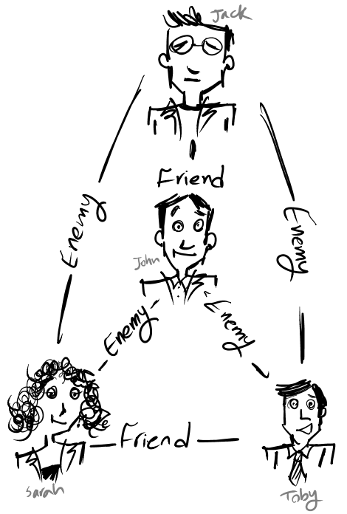
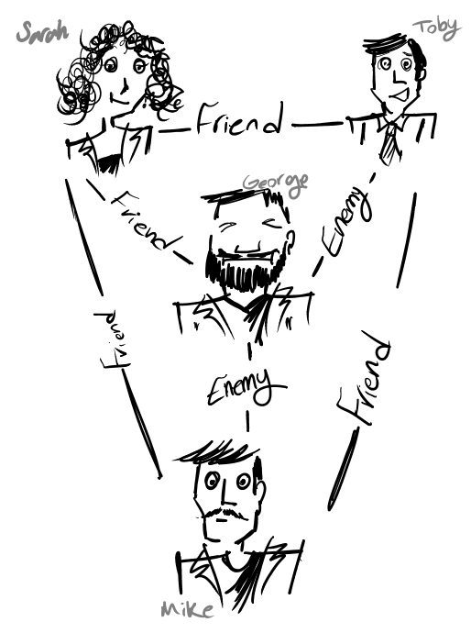



Slide 4
Just 1 edge away
from total balance

Slide 5








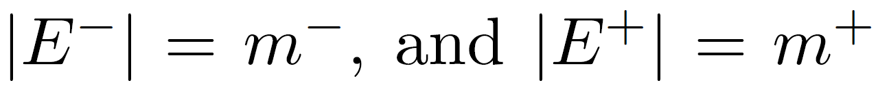
Undirected signed graph

Slide 6



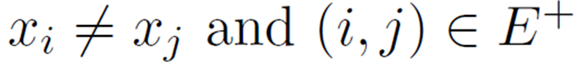
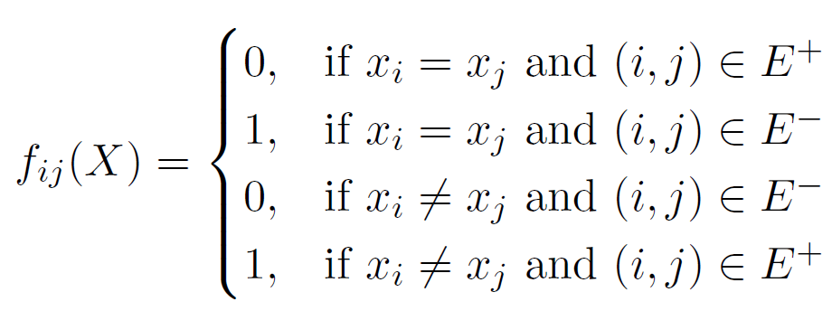
Frustrated edges under colouring
colour of node (binary variable)
A positive edge with different endpoint colours:
A negative edge with the same endpoint colours:

Slide 7
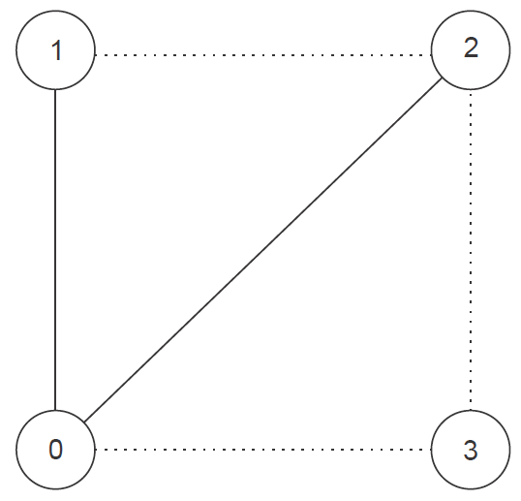
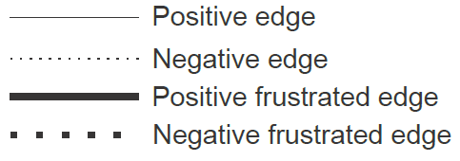

Slide 8
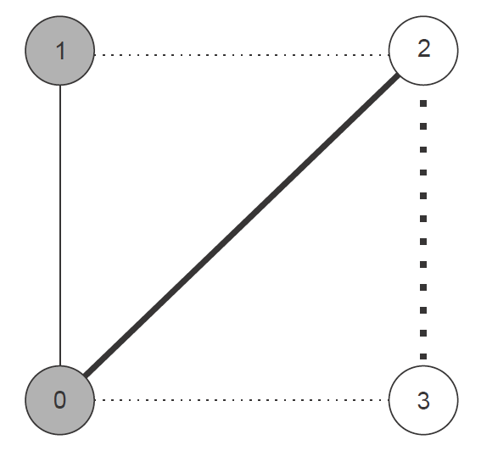

Slide 9
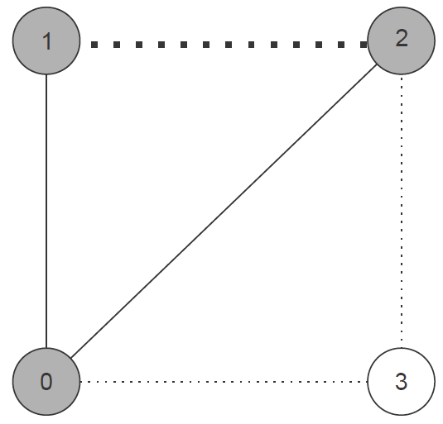

Slide 10
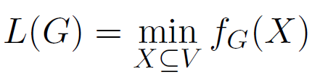
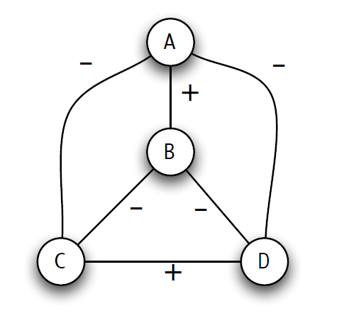
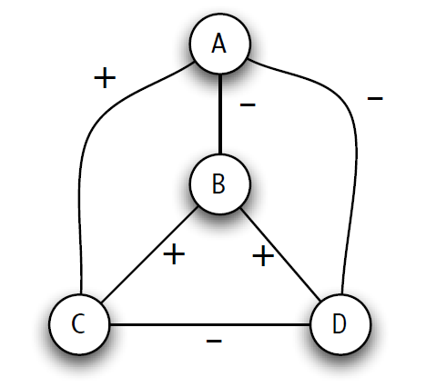

Balance and frustration
There is a node colouring under which the number of frustrated edges is minimal.
  for a balanced graph the minimum equals 0
  for an unbalanced graph the minimum is >0 and we represent it by
    =0 =1
[2]
Figures: D. Easley and J. Kleinberg, Networks, crowds, and markets: Reasoning about a highly connected world. pp 122 Cambridge University Press, 2010

Slide 11
The frustration index of graph
Why?
  To measure how close a network is to structural balance this also has applications in nano-materials, physics, biology, finance, and electronics
How?
  By developing a mathematical programming model to efficiently compute it
Notes:
In biology, decomposition of network into monotone subsystems -which is essential for understanding Drosophila segment polarity-
In finance, managing risk in a portfolio of securities
In physics, the frustration index provides the minimum energy state of magnetic materials
In international relations, signed clustering of countries in a region
In nanomaterials, bipartite edge frustration has applications on the stability of fullerene, a carbon allotrope
In electronics, frustration index helps finding the minimal set of phase conflicts in integrated circuit design
In Knot theory, the Writhe of a link diagram is a measure directly related

Slide 12
Models

Slide 13
A binary variable representing the frustration of an edge based on endpoint colours

Slide 14
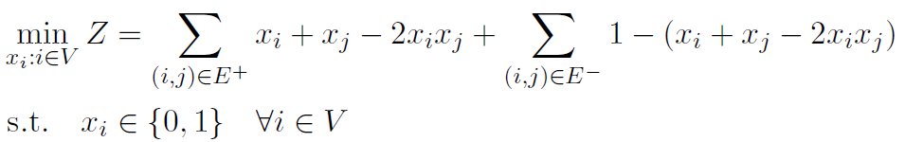
Unconstrained Binary Quadratic Programming (UBQP)
We also developed 3 binary linear models and several speed-up techniques
Notes:
n binary variables representing node colours
No constraints

Slide 15
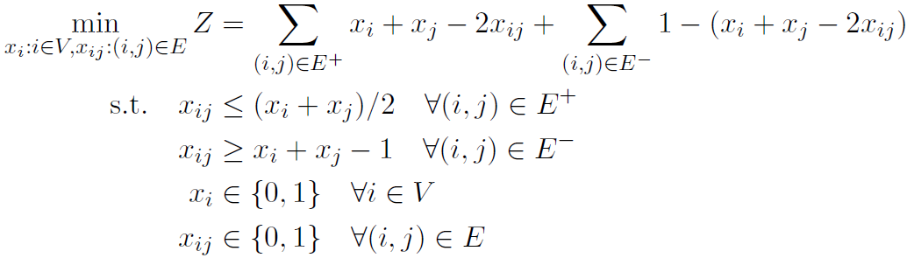
Binary Linear Programming (AND)
n+m variables (binary)
  Node variables represent node colours
  Edge variables represent AND of the node variables
m constraints (inequality)

Slide 16
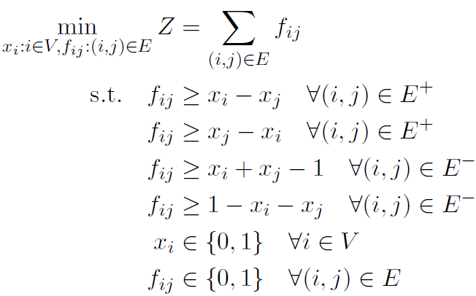
Binary Linear Programming (XOR)
n+m variables (binary)
  Node variables represent node colours
  Edge variables represent the edge negation state (XOR of the node variables)
2m constraints (inequality)

Slide 17
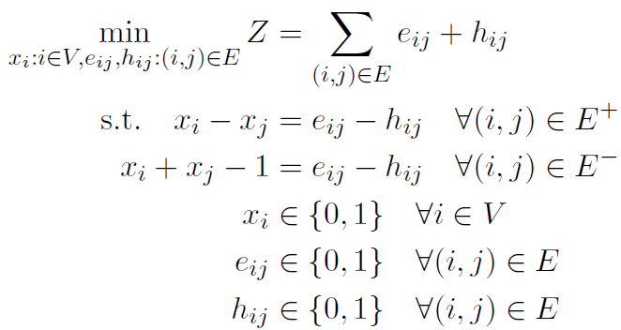
Binary Linear Programming (ABS)
n+2m variables (binary)
m constraints (equality)

Slide 18
Three linear models
UBQP
AND
XOR
ABS
Variables
Constraints
Variable type
Constraint type
Objective function
n
0
binary
--------------------------------
quadratic
n+m
m
binary
linear inequality
linear
n+m
2m
binary
linear inequality
linear
n+2m
m
binary
linear equality
linear

Slide 19
What Do We Expect on Synthetic Data?

Slide 20
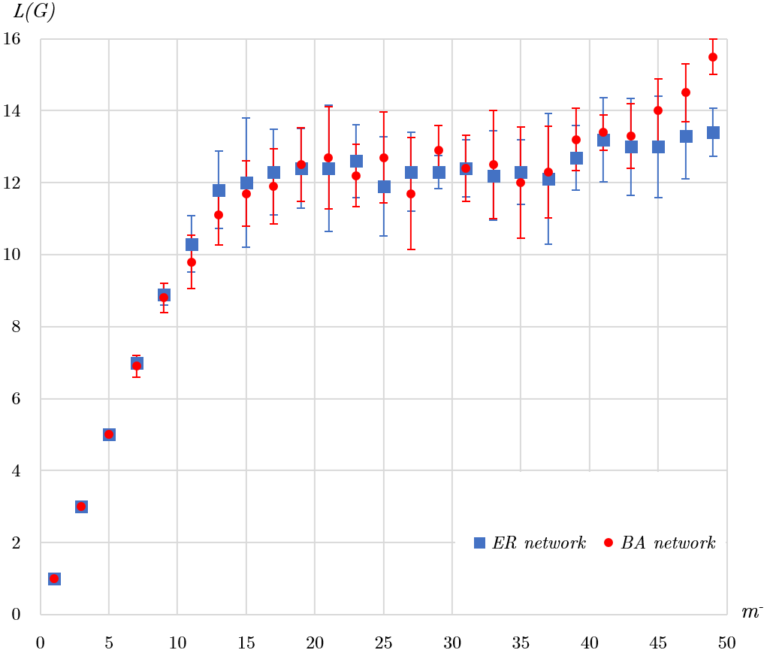
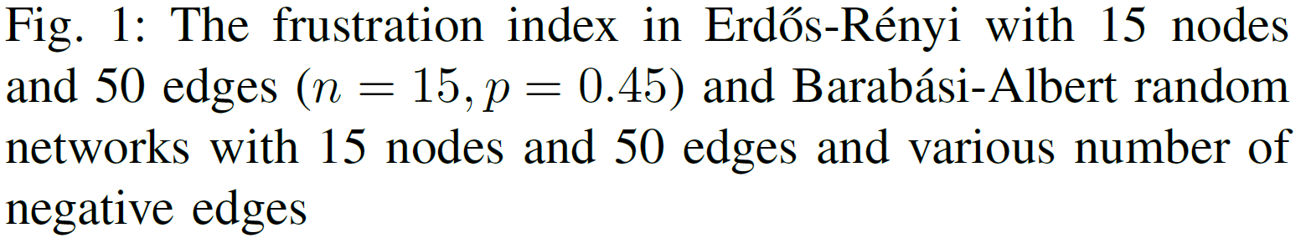

Slide 21
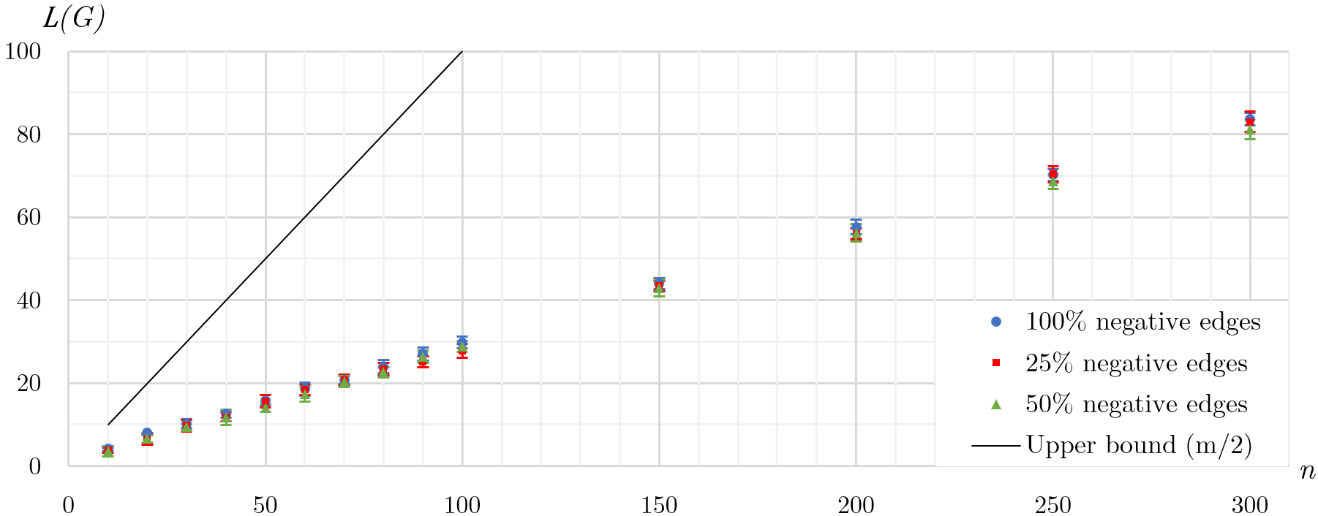

Slide 22
Results on
Real Networks

Slide 23
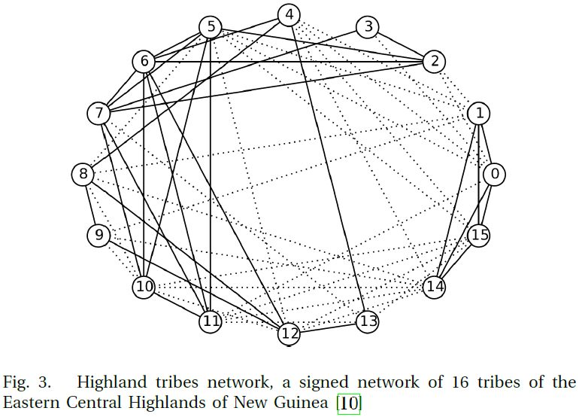

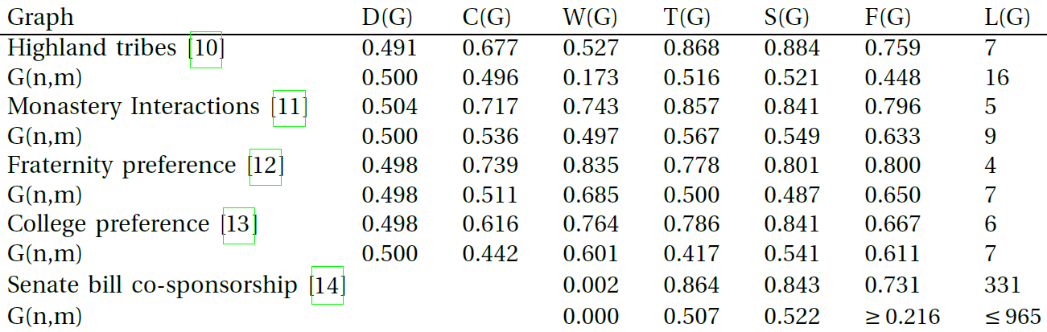
G1: New Guinean Tribes
(Read’s dataset) [10]
Tribes
Reshuffled
7
15

Slide 24
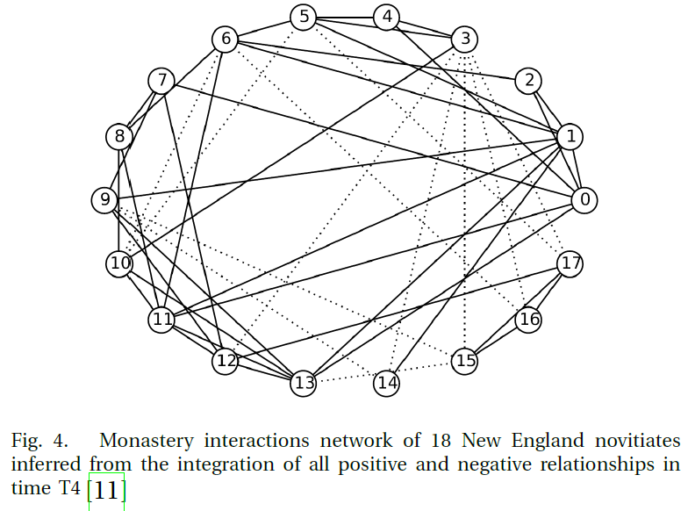

G2: Novitiates
(Sampson’s dataset T4) [11]
Monks
Reshuffled
5
10

Slide 25
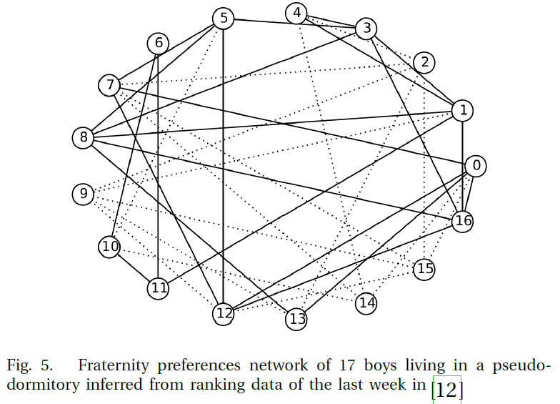

G3: College boys
(Newcomb’s dataset) [12]
College boys
Reshuffled
4
8

Slide 26
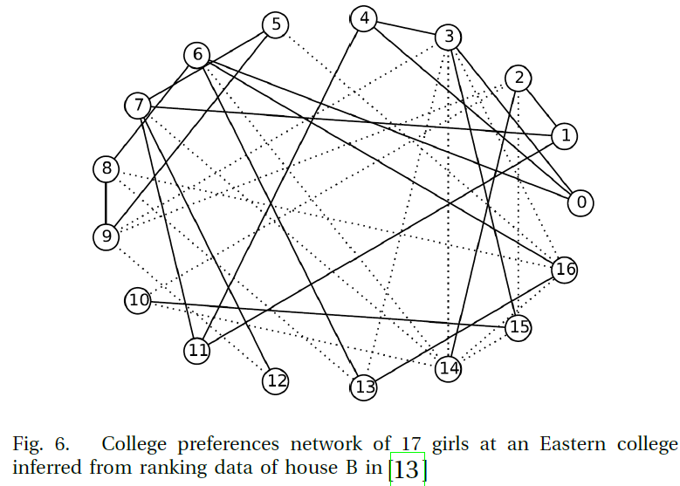

G4: College girls
(Lemann’s dataset) [13]
College girls
Reshuffled

Slide 27
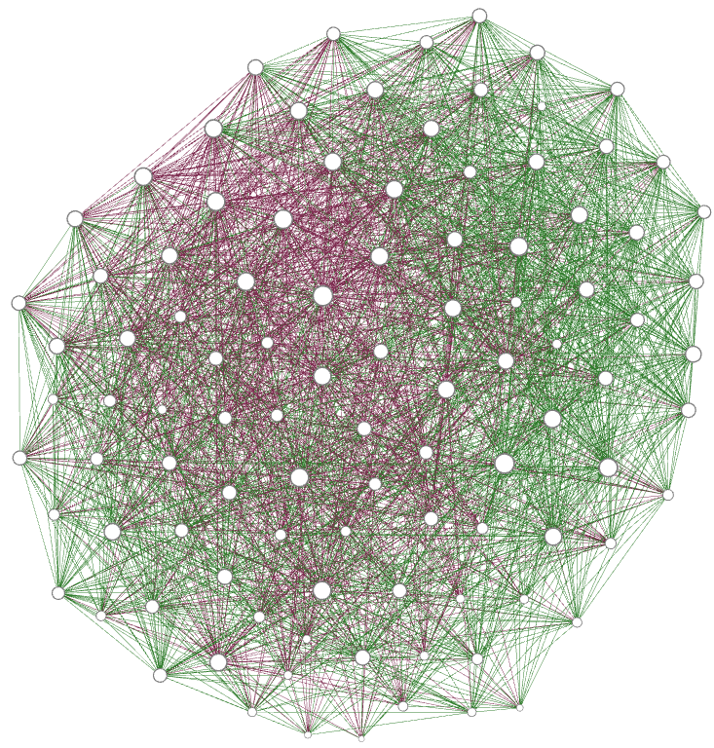

G5: US senators (inferred by Zachary Neal from Fowler’s dataset) [14]
US senators
Reshuffled
331
974

Slide 28
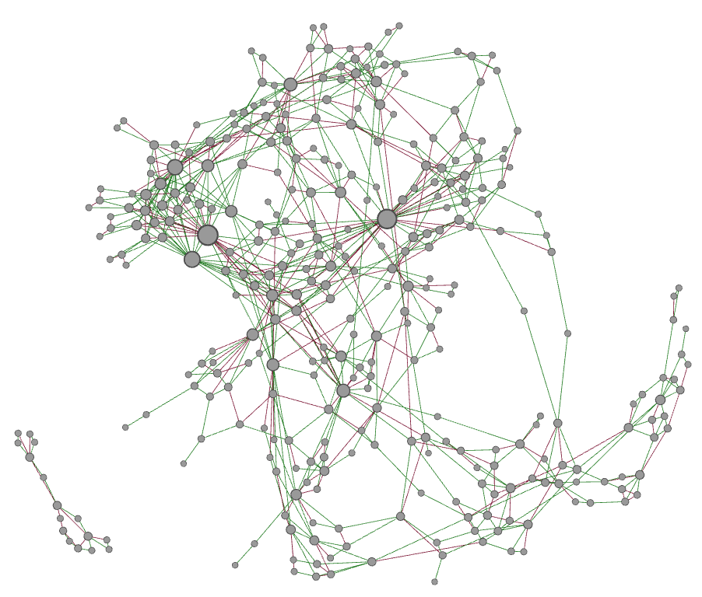
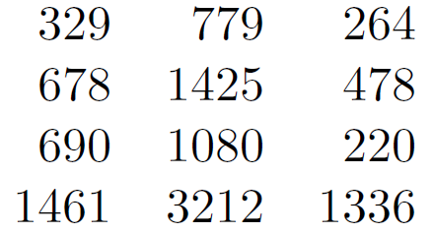
G6: Epidermal Growth Factor Receptor (EGFR) pathway [15]
EGFR
Reshuffled
193
149

Slide 29
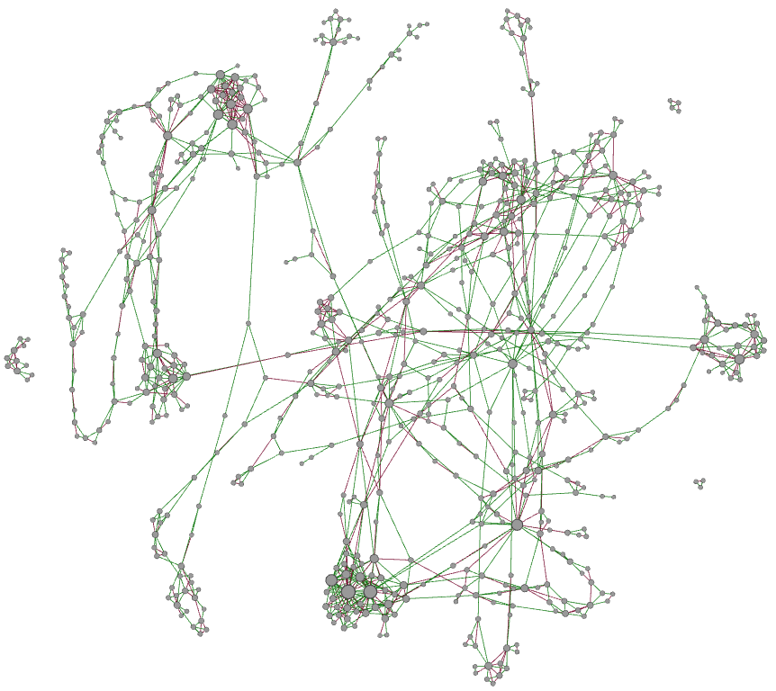
G7: Molecular interaction map of macrophage [16]
macrophage
Reshuffled
332
253

Slide 30
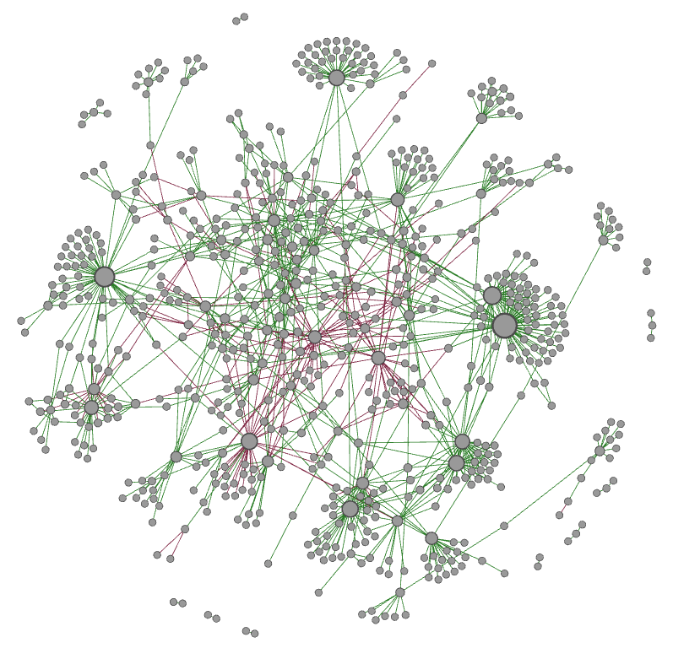
G8: The gene regulatory network of Saccharomyces cerevisiae (yeast) [17]
yeast
Reshuffled
41
114

Slide 31
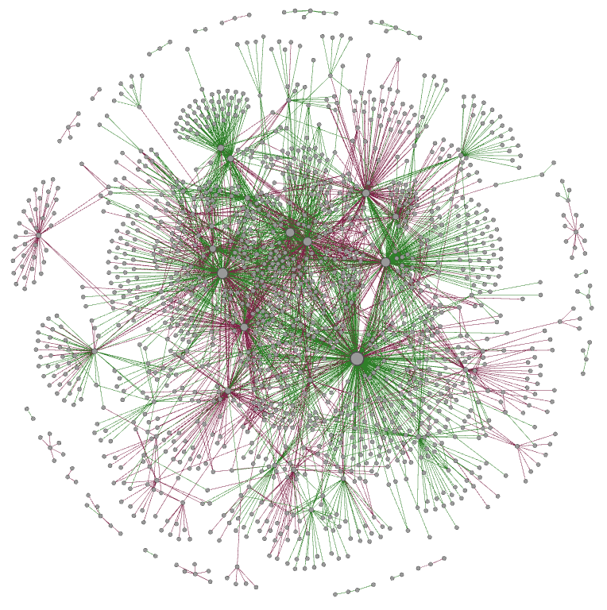
G9: the gene regulatory network of the Escherichia coli bacterium (E.coli) [18]
E.coli
Reshuffled
371
652

Slide 32
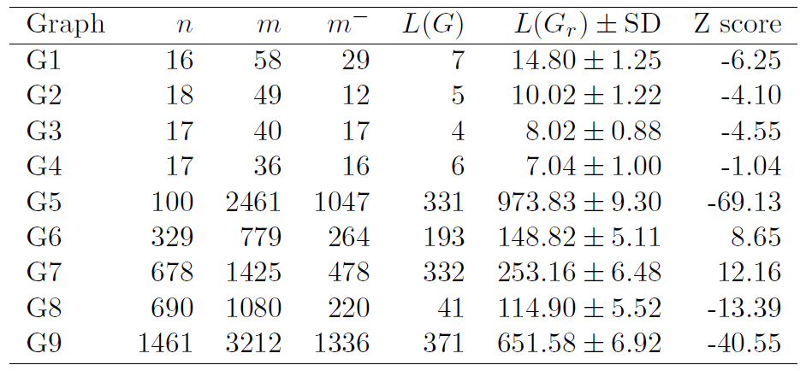
How close to balance?

Slide 33
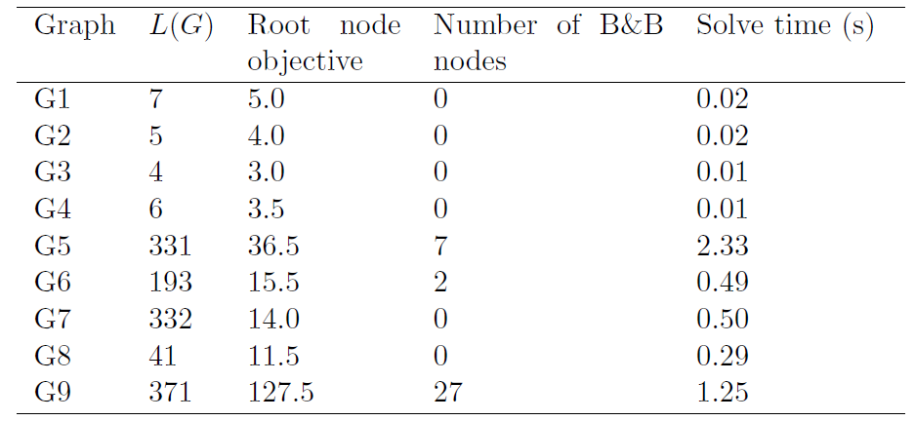
The performance of ABS model

Slide 34
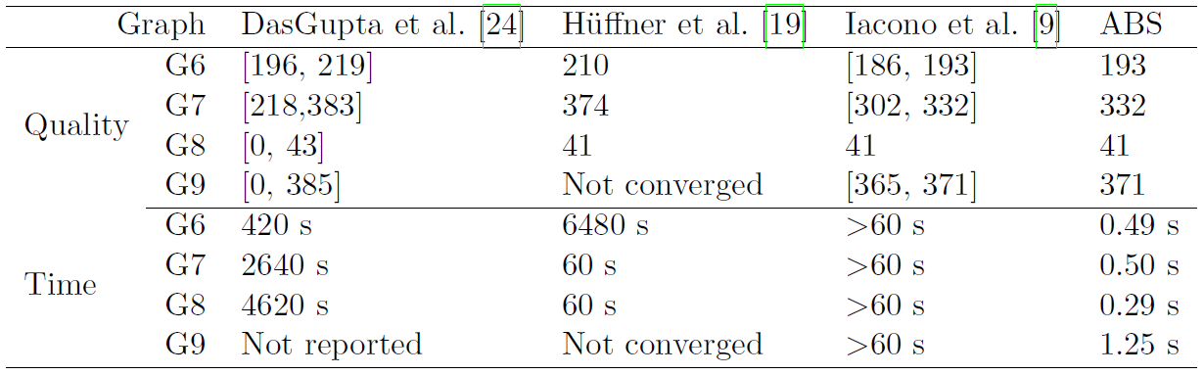

Solve time and solution quality for the biological networks
[19]
[20]
[21]
Our model
Notes:
Approximation algorithm
Data reduction scheme and an iterative compression algorithm
Heuristic algorithm

Slide 35
G10: Signed international relations
Correlates of War dataset (1946-1996)
Visualisation

Slide 36
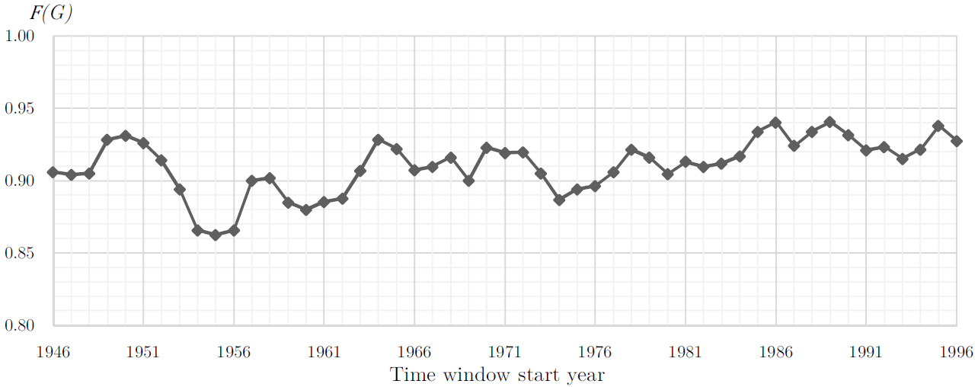

G10: Signed international relations
Correlates of War dataset (1946-1996)
Normalised for the number of edges

Slide 37
Extensions to the model
Weighted signed graphs
More than 2 colours
  Generalised balance theory (weak balance)
  Correlation clustering problem

Slide 38
References
F. Heider, “Social perception and phenomenal causality.” Psychological review, vol. 51, no. 6, p. 358, 1944.
D. Easley and J. Kleinberg, Networks, crowds, and markets: Reasoning about a highly connected world. Cambridge University Press, 2010.
D. Cartwright and F. Harary, “Structural balance: a generalization of Heider’s theory.” Psychological review, vol. 63, no. 5, p. 277, 1956.
F. Harary, “On the measurement of structural balance,” Behavioral Science, vol. 4, no. 4, pp. 316–323, Oct. 1959
R. Z. Norman and F. S. Roberts, “A derivation of a measure of relative balance for social structures and a characterization of extensive ratio systems,” Journal of mathematical psychology, vol. 9, no. 1, pp. 66–91, 1972.
E. Terzi and M. Winkler, “A spectral algorithm for computing social balance,” in Algorithms and models for the web graph. Springer, 2011, pp. 1–13.
E. Estrada and M. Benzi, “Walk-based measure of balance in signed networks: Detecting lack of balance in social networks,” Physical Review E, vol. 90, no. 4, p. 042802, 2014.
J. Kunegis, “Applications of Structural Balance in Signed Social Networks,” arXiv:1402.6865 [physics], Feb. 2014, arXiv: 1402.6865.
D. McCandless, Information is Beautiful by Univers Labs, source: multiple news reports
K. E. Read, “Cultures of the central highlands, New Guinea,” Southwestern Journal of Anthropology, pp. 1–43, 1954.
S. F. Sampson, “A Novitiate in a Period of Change,” An Experimental and Case Study of Social Relationships (PhD thesis). Cornell University, Ithaca, 1968.

Slide 39
References
T. Newcomb, The Acquaintance Process. New York: Holt, Rinehart and Winston.(1966)." The General Nature of Peer Group Influence", pps. 2-16 in College Peer Groups, edited by TM Newcomb and EK Wilson. Chicago: Aldine Publishing Co, 1961.
T. B. Lemann and R. L. Solomon, “Group characteristics as revealed in sociometric patterns and personality ratings,” Sociometry, pp. 7–90, 1952.
Z. Neal, “The backbone of bipartite projections: Inferring relationships from co-authorship, co-sponsorship, co-attendance and other co-behaviors,” Social Networks, vol. 39, pp. 84–97, 2014.
K. Oda, Y. Matsuoka, A. Funahashi, and H. Kitano, “A comprehensive pathwaymap of epidermal growth factor receptor signaling," Molecular systems biology,vol. 1, no. 1, 2005.
K. Oda, T. Kimura, Y. Matsuoka, A. Funahashi, M. Muramatsu, and H. Kitano,”Molecular interaction map of a macrophage," AfCS Research Reports, vol. 2, no. 14,pp. 1-12, 2004.
M. C. Costanzo, M. E. Crawford, J. E. Hirschman, J. E. Kranz, P. Olsen, L. S.Robertson, M. S. Skrzypek, B. R. Braun, K. L. Hopkins, P. Kondu, C. Lengieza,J. E. Lew-Smith, M. Tillberg, and J. I. Garrels, “Ypd, pombepd and wormpd:model organism volumes of the bioknowledge library, an integrated resource forprotein information," Nucleic Acids Research, vol. 29, no. 1, pp. 75-79, 2001
H. Salgado, S. Gama-Castro, M. Peralta-Gil, E. Diaz-Peredo, F. Sanchez-Solano,A. Santos-Zavaleta, I. Martinez-Flores, V. Jimenez-Jacinto, C. Bonavides-Martinez,J. Segura-Salazar et al., “Regulondb (version 5.0): Escherichia coli k-12 transcriptionalregulatory network, operon organization, and growth conditions," Nucleicacids research, vol. 34, no. suppl 1, pp. D394-D397, 2006.
B. DasGupta, G. A. Enciso, E. Sontag, and Y. Zhang, “Algorithmic and complexity results for decompositions of biological networks into monotone subsystems," Biosystems, vol. 90, no. 1, pp. 161-178, 2007.
F. Huffner, N. Betzler, and R. Niedermeier, “Separator-based data reduction for signed graph balancing," Journal of combinatorial optimization, vol. 20, no. 4, pp. 335-360, 2010.
G. Iacono, F. Ramezani, N. Soranzo, and C. Altafini, “Determining the distance to monotonicity of a biological network: a graph-theoretical approach," Systems Biology, IET, vol. 4, no. 3, pp. 223-235, 2010.
D. Easley and J. Kleinberg, Networks, crowds, and markets: Reasoning about a highly connected world. Cambridge University Press, 2010.

Slide 40
Questions?
Thank You
An exact method for computing the frustration index in signed networks using binary programming
Samin Aref, Andrew J. Mason, Mark C. Wilson
http://arxiv.org/abs/1611.09030v2

Slide 41
Appendix

Slide 42
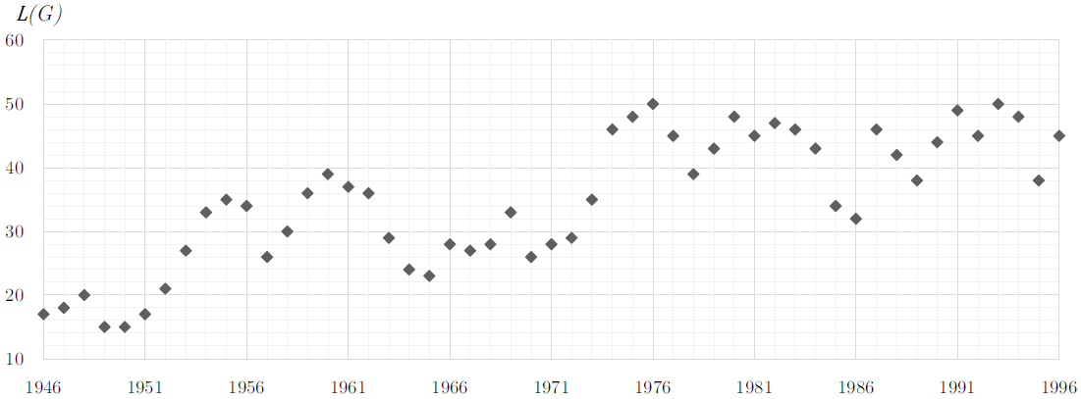

G10: Signed international relations

Slide 43
Measures of Partial Balance

Slide 44
Four main approaches
Cycles
  D(G)
  C(G)
Closed walks
  W(G)
Triads
  T(G)
Edge removal
  L(G)
  F(G)
Degree of balance (Cartwright and Harary 1956)
Weighted degree of balance (Norman and Roberts 1972)
Walk-based measure of balance (Estrada and Benzi 2014)
Triangle index (Cartwright and Harary 1956) (Terzi and Winkler 2011)
Frustration index (Harary 1959)
Normalised frustration index

Slide 45
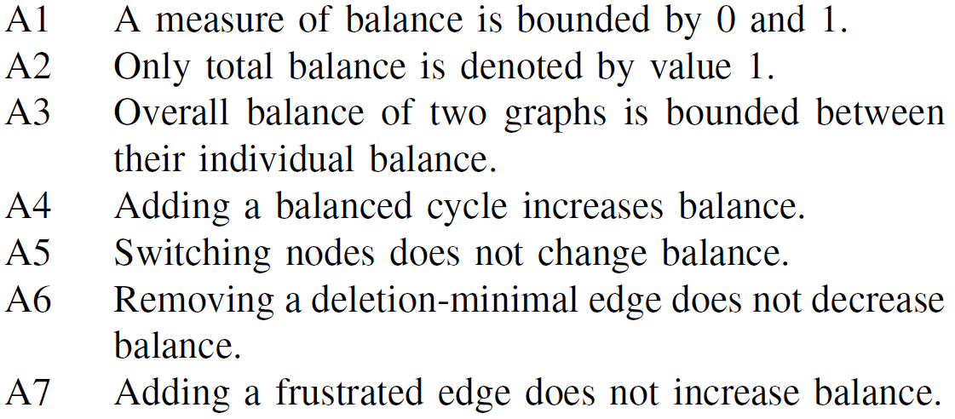
Axioms

Slide 46
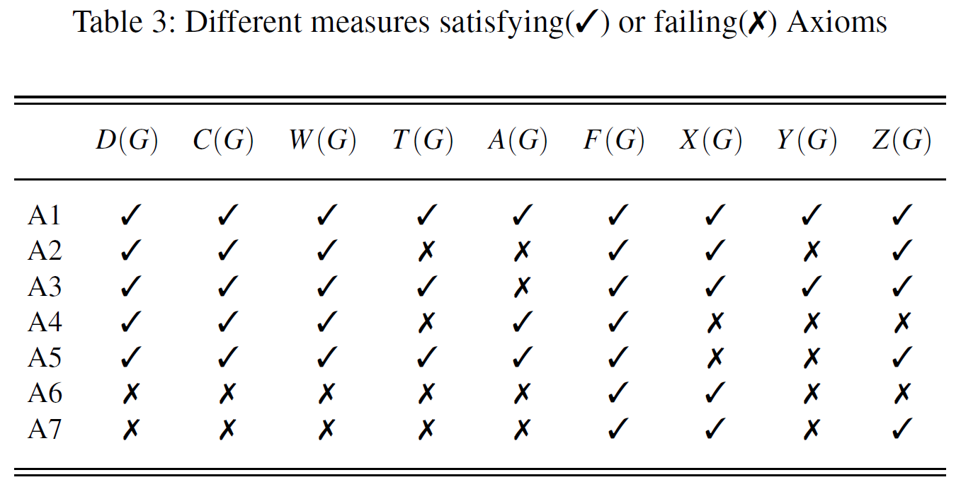
Axiomatic properties

